Slide 1
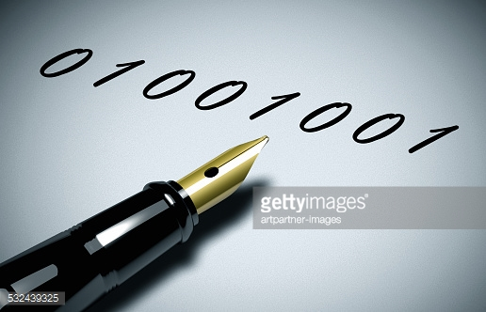
Digital Signature
a digital code (generated and authenticated by public key encryption) which is attached to an electronically transmitted document to verify its contents and the sender's identity.

Slide 2
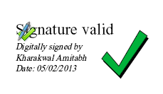
Digital Signatures
Used to “Sign” messages to validate the source and integrity of the contents.
Taking a digital picture of a written signature does not provide adequate security
Digitized written signature could easily be copied from one electronic document to another with no way to determine whether it is legitimate
Electronic signatures, on the other hand, are unique to the message being signed and will not verify if they are copied to another document
When you add them to a document, you are "signing" that document as a way of endorsing or agreeing with what the document says.

Slide 3
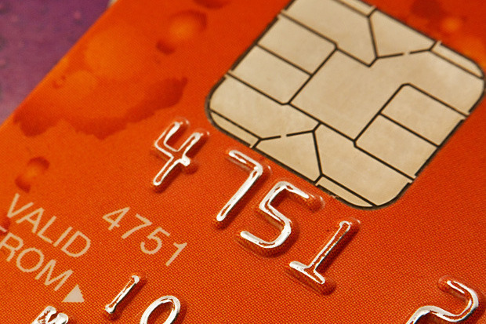

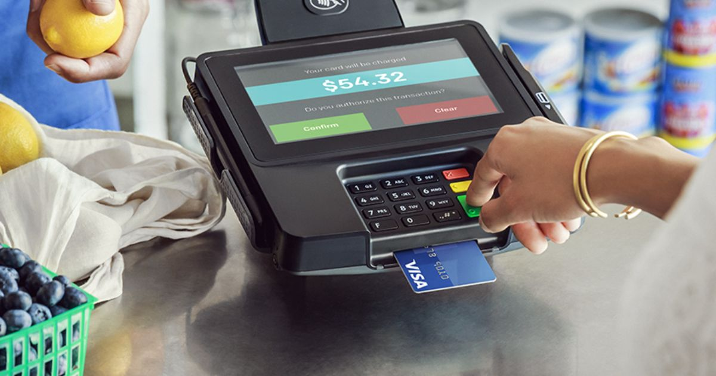
Unlike handwritten signatures, digital signatures are used only with computers.
They are electronic signatures that can be used to sign electronic documents, like word processing files or spreadsheets
A digital signature is a kind of ID.
'You can use it on the Internet to identify yourself in a secure manner.
This is extremely useful in areas such as electronic commerce
For instance, when making a credit card purchase on the Internet, you can use your digital signature to "sign" that purchase.
This helps to ensure that only you can make purchases with your credit card number.

Slide 4
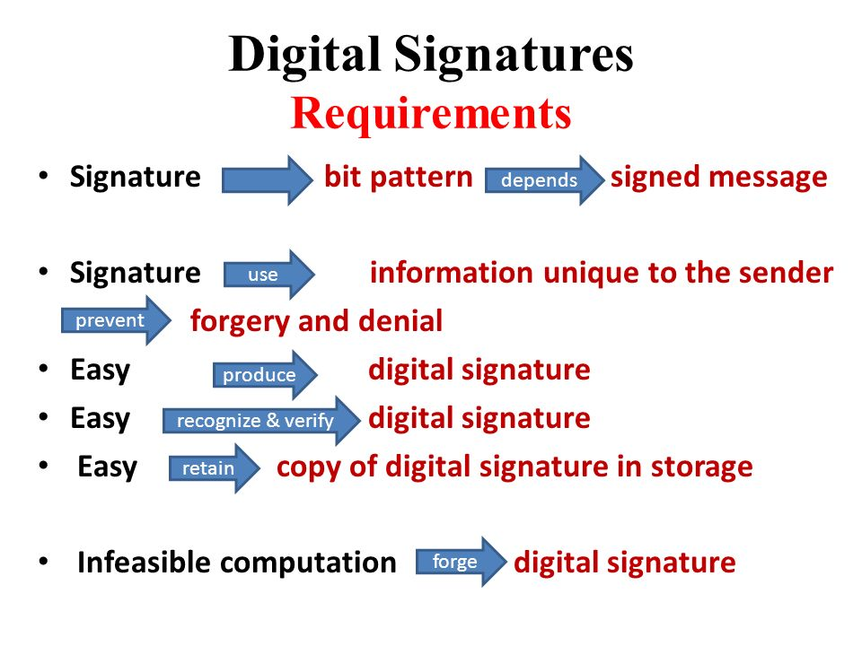

Slide 5
Requirements for a Digital Signature
The signature must be a bit pattern that depends on the message being signed
The signature must use some information unique to the sender, to prevent both forgery and denial.
It must be relatively easy to produce digital signature.
It must be relatively easy to recognize and verify the digital signature.
It must be computationally infeasible to forge a digital signature, either by constructing a new message for an existing digital signature or by constructing a fraudulent digital signature for a given message.
It must be practical to retain a copy of the digital signature in storage.

Slide 6
How is a Digital Signature Produced?
Very briefly, a typical digital signature works like this:
  A signature in the form of a code is generated by applying an algorithm, such as RSA, and the sender's private key to some or all of the message contents.
  The recipient verifies the signature by decrypting it using the sender's public key.

Slide 7
ENCRYPT WITH
SENDER’S
PRIVATE KEY
PLAIN TEXT
SENDER
RECEIVER
CIPHER TEXT
SENDER SENDS
ENCRYPTED
MESSAGE TO
RECEIVER

Slide 8
Basis for Digital Signature
ENCRYPT WITH
SENDER’S
PRIVATE KEY
SENDER
RECEIVER
NETWORK
PLAIN
TEXT
CIPHER
TEXT
CIPHER
TEXT
SENDER SENDS
ENCRYPTED
MESSAGE TO
RECEIVER
DECRYPT WITH
SENDER’S
PUBLIC KEY

Slide 9
What purpose will it serve?
Sender’s public key is accessible by anybody . This means that any one can decrypt using public key thus causing failure to encryption scheme
Though this sounds true the intension of sender is not confidentiality ;
If the decryption was successful it is well ensured that it was sent by A only because private key is known only to sender alone. So this scheme achieves authentication i.e identifies and proves A is the sender
In case of dispute tomorrow, B can take the cipher text decrypt with A’s public key and prove that it came only from A. This achieves non-repudiation

Slide 10
If C intercepts?
Let C intercept the ciphertext
Use the public key of A and reads the message
Changes the message that would not achieve any purpose
Because C doesn’t have A’s private key, so cannot encrypt with private key again
Even if C forwards the message to B he will not believe that it came from A as it was not encrypted with private key of A.
This scheme where you encrypt with private key and decrypt with public key to ensure authentication , integrity and non-repudiation, is called digital signature.

Slide 11
Problems faced
As it deals with asymmetric scheme, if the plain text is large, process could become slow.
This can be tackled by digital envelope
Yet another Efficient scheme used today is message digest also called hash

Slide 12
What is the message digest?
A message digest is a cryptographic hash function containing a string of digits created by a one-way hashing formula. Message digests are designed to protect the integrity of a piece of data or media to detect changes and alterations to any part of a message.

Slide 13
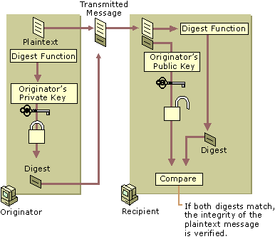

Slide 14
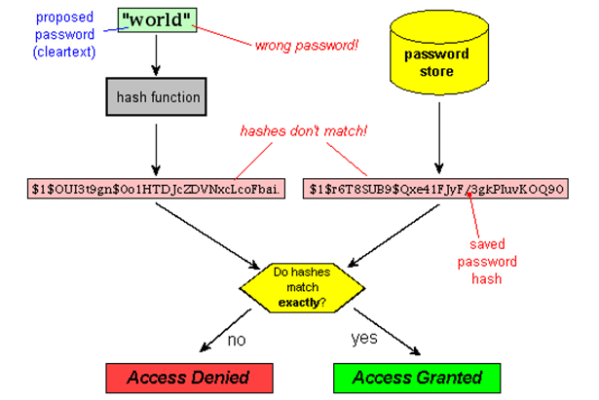

Slide 15
Message Digest
Message digest is called a finger print or the summary of the message
This is used to verify the integrity of the data
i.e it has not been tampered before it reaches the receiver
This requires a calculation of LRC – Longitudinal Redundancy Check

Slide 16
LRC
Original data
11100100 11011101 00111001 00101001
11100100
11011101
00111001
00101001
Original data arranged
as rows of a list
Even parity : 0 Column 1
Odd Parity : 1 Column 3
00101001
11100100 11011101 00111001 00101001
00101001
Original data and LRC

Slide 17
How to calculate LRC?
If we want to send 32 bits , arrange them horizontal row (4 horizontal rows)
Check how many one bits occur
If the number of 1s is odd then call it as odd parity
Otherwise even parity
This LRC is originally fingerprint of the original message
Data along with LRC is sent to the receiver
Receiver separates the data block and LRC block
Performs LRC on data block alone and compares with the one sent
If they match receiver has reasonable confidence.

Slide 18
Idea of message digest
Similar principle as LRC
Suppose we have a number 4000, we divide it by 4 and get 1000;
Thus 4 is the fingerprint of 4000
Always 4000/4 = 1000
If you change 4000 or 4 then the result will not be same
If just given the number 4 we cannot track 4 is by 4 x 1000
Similarly fingerprint of a message does not say anything about the message
There are infinite possibilities for possible equations

Slide 19
Example
Original number is 7391743
Operation Result
Multiple 7 by 3 21
Discard the first digit 1
Multiply 1 by 9 9
Multiply 9 by 1 9
Multiply 9 by 7 63
Discard the first digit 3
Multiply 3 by 4 12
Discard the first digit 2
Multiply 2 by 3 6
MESSGAE DIGEST IS 6

Slide 20
Message digests
So far we are considering very simple case of message digest
Actually message digest are not so small and straight forward to complete
Usually consists of 128 or more bits
Therefore the chance of two digests being the same is between 0 to 2 ¹²⁸
The message digest is chosen so long with the purpose that it minimizes two digests being the same.

Slide 21
Requirements of message digest
Given a message it should be very easy to find its corresponding message digest.
Also for a given message the message digest must always be the same

Slide 22
SHOULD BE POSSIBLE
AND THE RESULT
SHOULD ALWAYS
BE THE SAME
Original Data
Message Digest
Algorithm
Message Digest

Slide 23
Requirements of message digest
Given the message digest it should be very difficult to find the original message for which the digest was created

Slide 24
Message Digest
SHOULD NOT
BE POSSIBLE
Reverse
Message Digest
Algorithm
Original data

Slide 25
Requirements of message digest
Given two messages if we calculate their message digests the two digests must be different

Slide 26
Original Data 1
Original Data 2
Message Digest
Algorithm
Message Digest
Algorithm
Message Digest 1
Message Digest 2
These two message digests must be different

Slide 27
Message Digest Example
MESSAGE
Please pay the newspaper bill today
MESSAGE DIGEST
306706092A864886F70D010705A05A30580
……………………………………………………
-----------------------------------------------------646
MESSAGE
Please pay the newspaper bill tomorrow
MESSAGE DIGEST
306A06092A864886F70D010705A05D305B020
……………………………………………………
--------------------------------------------------C6C20746

Slide 28
What is a hash function?
A hash function is any function that can be used to map data of arbitrary size to data of fixed size.
The values returned by a hash function are called hash values, hash codes, hash sums, or simply hashes.
Since the hash is short, using the hash instead of the original input is much faster.
Cryptographic hash functions take an input of arbitrary length and produces a message digest that is of a fixed, short length (e.g. 128 or 160 bits).
The digest is sometimes also called the "hash" or "fingerprint" of the input

Slide 29
What is one way encryption?
One-way encryption, or a one-way hash function, is designed in such a way that it is hard to reverse the process, that is, to find a string that hashes to a given value (hence the name one-way.)
A good hash function also makes it hard to find two strings that would produce the same hash value.

Slide 30
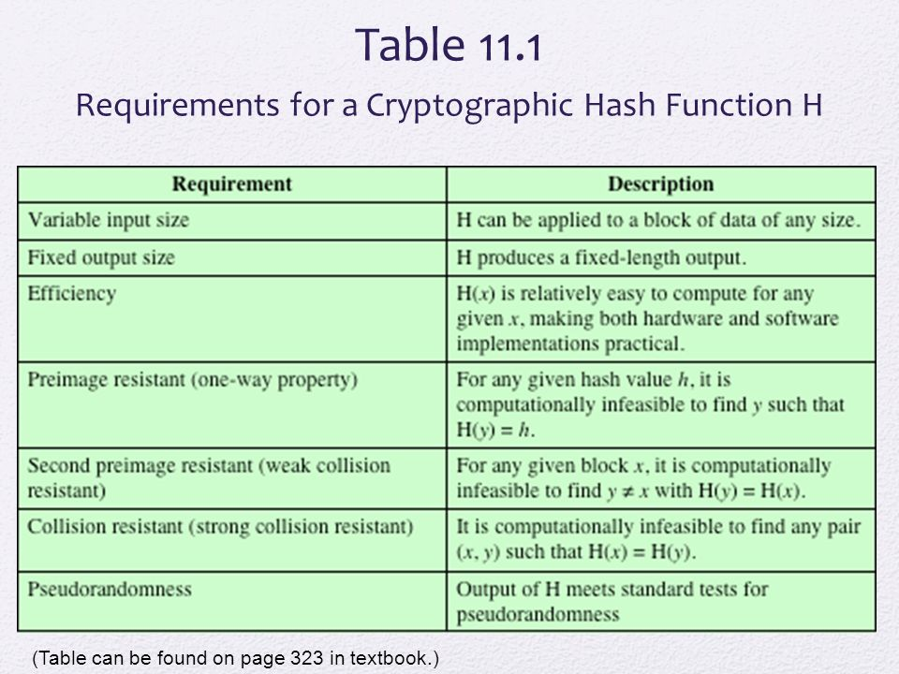

Slide 31
Requirements for One-way Hash Function
H can be applied to a block of data of any size.
H produces a fixed length output
H(x) is relatively easy to compute, making hw/sw implementations practical
For any given code m it is computationally infeasible to find x such that H(x)=m
For any given block x, it is computationally infeasible to find y not= x with H(x)=H(y)

Slide 32
What is a md5 hash?
The MD5 message-digest algorithm is a widely used cryptographic hash function producing a 128-bit (16-byte) hash value, typically expressed in text format as a 32 digit hexadecimal number. MD5 has been utilized in a wide variety of cryptographic applications, and is also commonly used to verify data integrity.

Slide 33
Next Class
MD5 Algorithm for Message Digest

